Slide 1


NLP TOOLKIT
A web application for all things related to natural language processing.
Developed By:
Aman Kumar Pandey - (21MCA10061)
Under the Guidance of:
Dr. Raghavendra Mishra

Slide 2
NLP TOOLKIT
A web application for all things related to natural language processing.
Under the Guidance of:
Dr. Raghavendra Mishra
(Assistant Professor – VIT Bhopal University)
Developed By:
Aman Kumar Pandey - (21MCA10061)

Slide 3
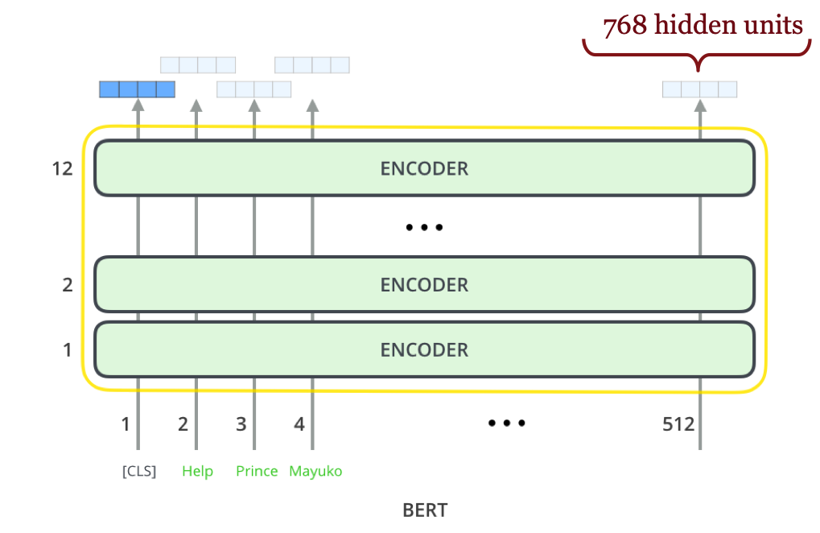
NLP TOOLKIT ?
In NLP TOOLKIT we will be trying to create a web application for all things related to natural language processing using BERT.
BERT : BERT or Bidirectional Encoder Representations from Transformers is an open-source machine learning framework for NLP. BERT is designed to help computers understand the meaning of ambiguous language in text by using surrounding text to establish context.
It can be mainly used for Machine Translation, Text Summarization, Sentiment Analysis, Question Answering (chatbot), and Text Summarization.
What we are building:
In our project we are going to create a web application for:
1. Text Summarization
2. Sentiment Analysis

Slide 4
NLP TOOLKIT

Slide 5
NLP TOOLKIT
PROPOSED WORK
01

Slide 6
01.
PROPOSED WORK
WHAT WILL WE BUILD?
AI – at the core of everything we do
Sentiment Classifier
Summarize Text from News Articles, or upload an entire book as a text file. Or simply type out the text for summarization.
Web App- Deployed using Flask, a light weight Web App Framework

Slide 7
01.
PROPOSED WORK
HOW DO WE BUILD IT?
INTRODUCING BERT
A new, state of the art language representation model.
A FULLY AI DRIVEN WEB APP
A scalable web application that can perform Automatic Summarization and many other NLP tasks in the future.
FLASK
A lightweight Python web-framework for deploying trained models.

Slide 8
01.
PROPOSED WORK
SUMMARIZATION
“Automatic text summarization is the task of producing a concise and fluent summary while preserving key information content and overall meaning”
Extractive
Abstractive
Extract Summary
from the text.
Generate new sentences from the original text.

Slide 9
01.
PROPOSED WORK
SUMMARIZATION FEATURES
Text input will be taken from text files uploaded to the application.
Text input will be taken though the form body
INPUT TEXT FROM USER
INPUT TEXT USING FILE UPLOAD
INPUT TEXT FROM NEWS ARTICLE LINKS
NUMBER OF SENTENCES and Type of Summarization according to user Input

Slide 10
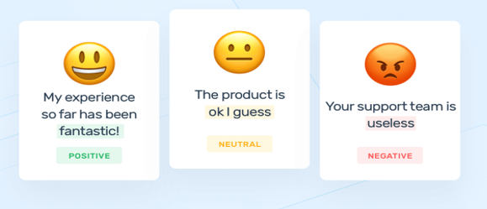
01.
PROPOSED WORK
Sentiment Analysis: Using BERT
Sentiment analysis is a Natural Language Processing (NLP) technique used to determine whether data is positive, negative or neutral.
Sentiment analysis is often performed on textual data to help businesses monitor brand and product sentiment in customer feedback, and understand customer needs.

Slide 11
01.
PROPOSED WORK
Types of Sentiment Analysis
Graded Sentiment Analysis
Emotion detection
Aspect-based Sentiment Analysis
Multilingual sentiment analysis
Graded Sentiment Analysis:
As The polarity precision is important to us, Therefore we might consider expanding your polarity categories to include different levels of positive and negative:

Slide 12
01.
PROPOSED WORK
Very positive 5
Positive 4
Neutral 3
Negative 2
Very negative 1
It Is used on various platform like IMDb, Ecommerce Web-sites where end user rates a particular product or a thing or movie out of 5 stars.
Automatically analyzing customer feedback, such as opinions in survey responses and social media conversations, allows brands to learn what makes customers happy or frustrated, so that they can tailor products and services to meet their customers’ needs.

Slide 13
01.
PROPOSED WORK
Steps That We Followed While Making SA Using Bert
Installing and Import Dependencies
Instantiate Model
Encode And Calculate Sentiment
Collect Reviews
Load Reviews into Data frame and Score

Slide 14
NLP TOOLKIT
REAL TIME USAGE
02

Slide 15
02.
REAL TIME USAGE
WHY BUILD a SUMMARIZER-APPLICATIONS:
Summarization is the task of condensing a piece of text to a shorter version
To reduce the size of the initial text while at the same time preserving key informational elements and the meaning of content.

Slide 16
02.
REAL TIME USAGE
REAL LIFE APPLICATION FOR TEXT SUMMARIZATION
NEWS SUMMARIZATION :- The news summarization approach is divided into two, namely extractive and abstractive. Extractive summarization means identifying important parts of the text and making it verbatim produce a subset of sentences from the original text; while abstractive summarization reproduces important material in new ways after the interpretation and examination of texts .
TEXT CLASSIFICATION :- Text clarification is the process of categorizing the text into a group of words. By using NLP, text classification can automatically analyze text and then assign a set of predefined tags or categories based on its context.
QUESTION ANSWERING :- Question answering is a critical NLP problem and a long-standing artificial intelligence milestone. QA systems allow a user to express a question in natural language and get an immediate and brief response. Example :- Chat bot

Slide 17
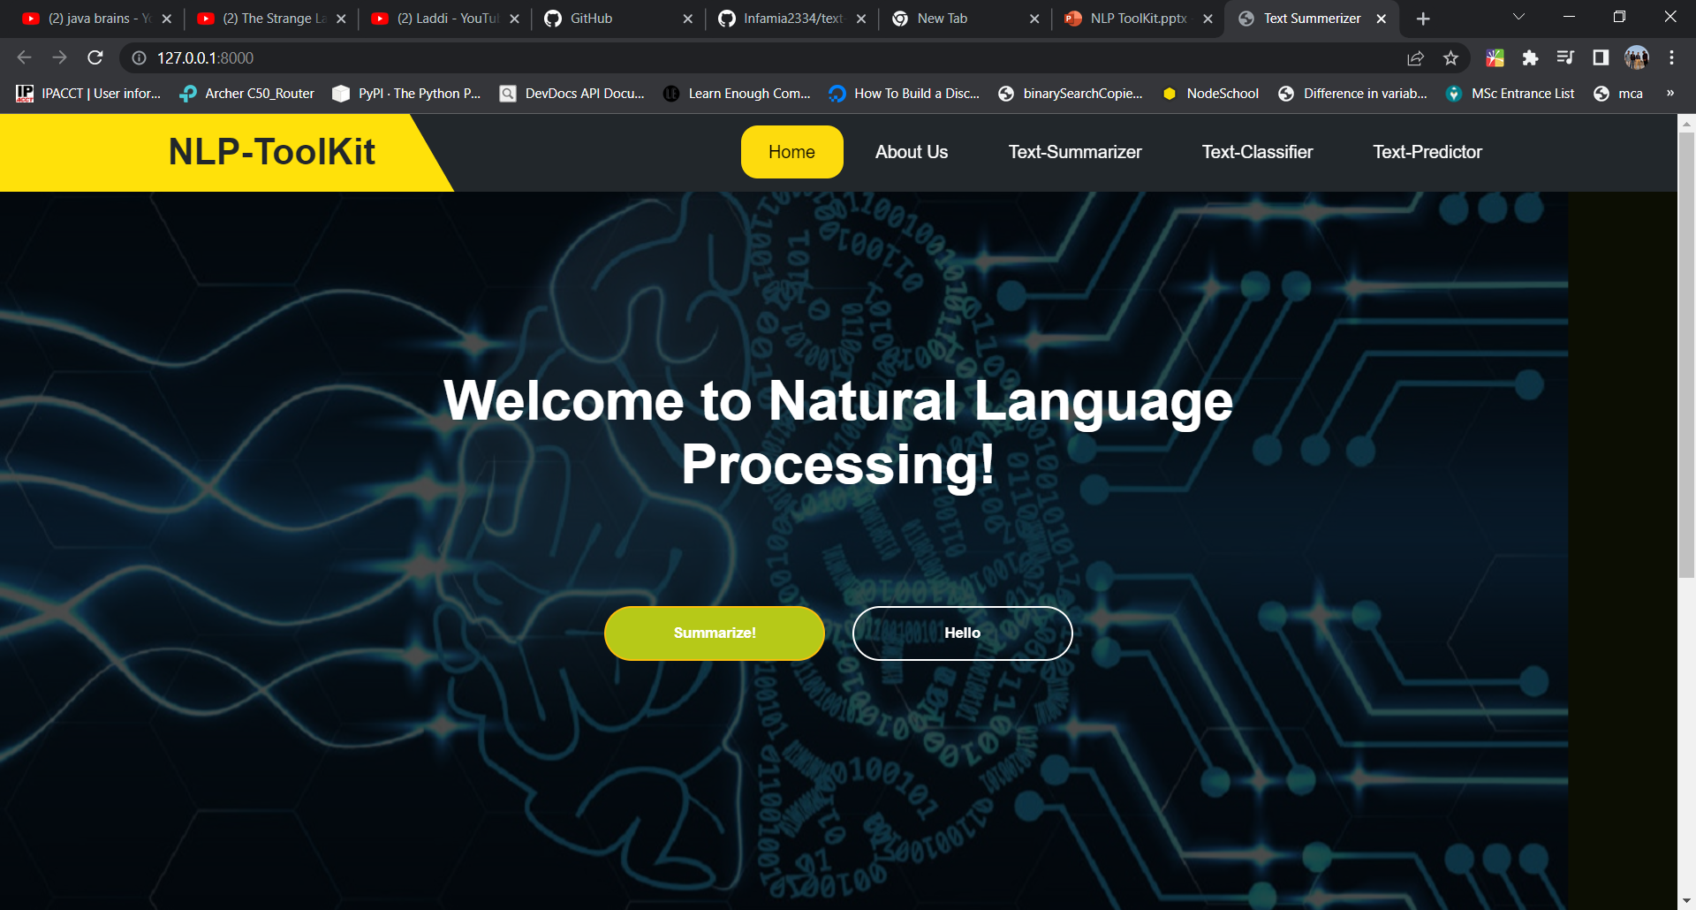
02.
REAL TIME USAGE
RESPONSIVE WEB APPLICATION
A web development approach that creates dynamic changes to the appearance of a website, depending on the screen size and orientation of the device being used to view it.
In this to make responsive website we will use :-
HTML /CSS
Java script
Bootstrap 4

Slide 18
NLP TOOLKIT
SYSTEM ARCHITECTURE
03

Slide 19
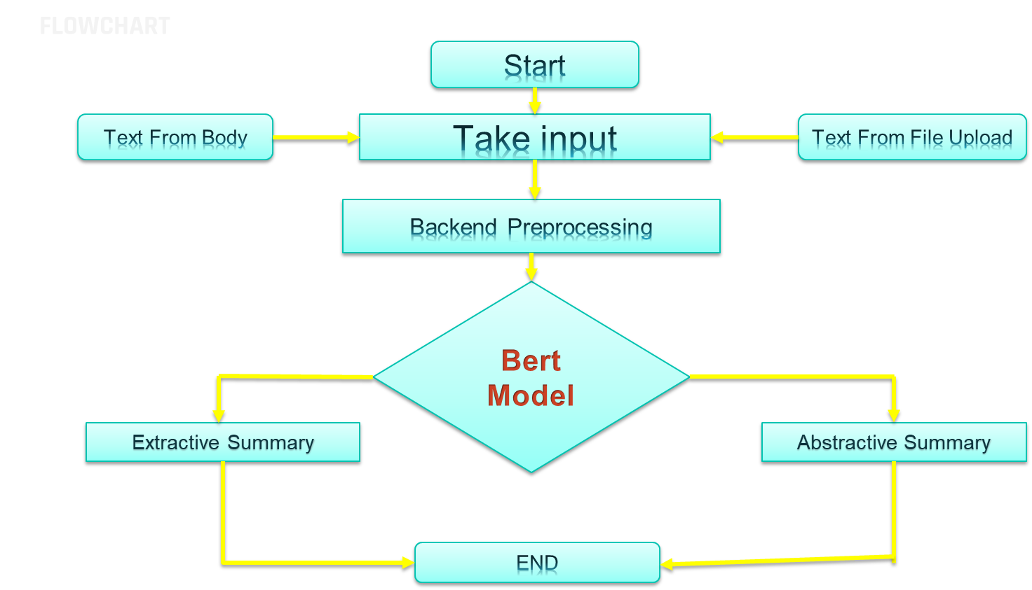
03.
SYSTEM ARCHITECTURE

Slide 20
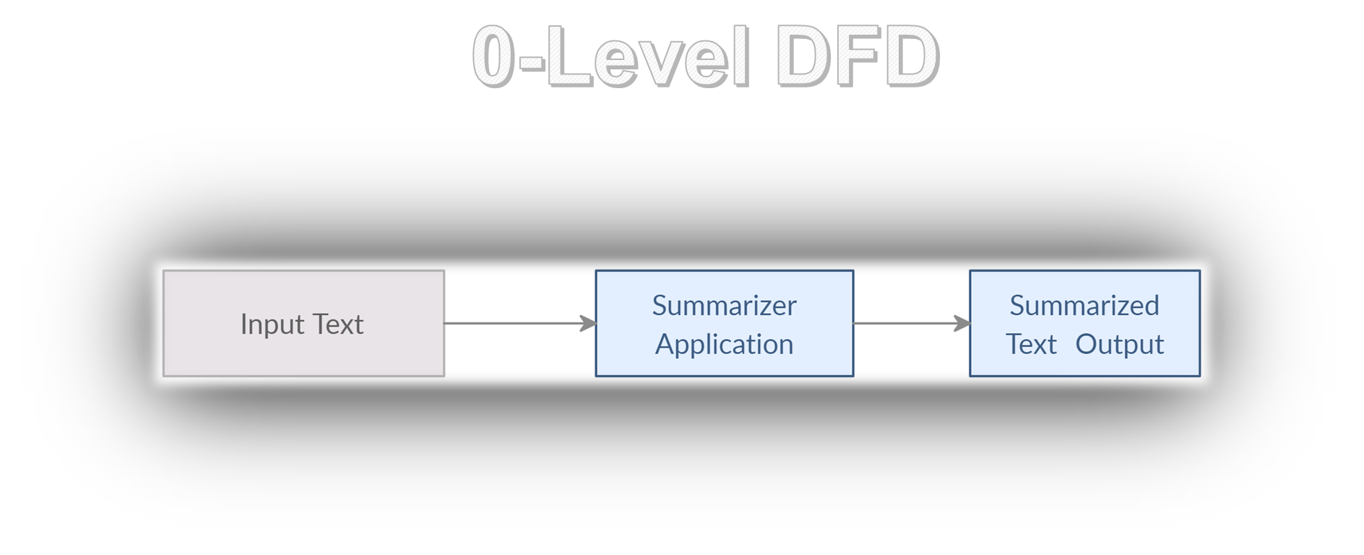
03.
SYSTEM ARCHITECTURE

Slide 21
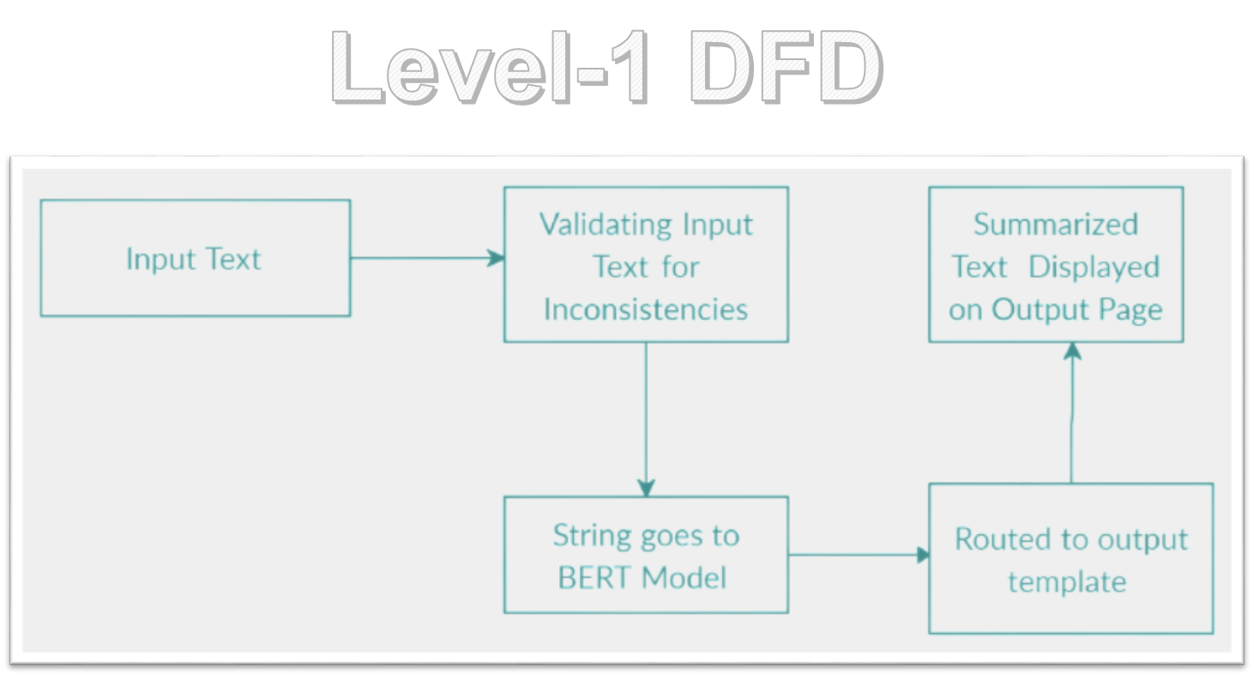
03.
SYSTEM ARCHITECTURE

Slide 22
NLP TOOLKIT
TECH-STACK
04

Slide 23
04.
TECH-STACK
Technologies Used
Python
GIT
The programming language – brief intro
Version control – collaboration and dev-ops, brief intro.
FLASK
The lightweight web framework and its brief intro

Slide 24
1. Python code is readable for new developers. 2. Python has a syntax that is easy to understand and friendly. 3. Python comes with a wide variety of libraries like PyTorch, TensorFlow. 4. PyTorch is an optimized tensor library primarily used for Deep Learning applications using GPUs and CPUs. It is an open-source machine learning library for Python, mainly developed by the Facebook AI Research team.
04.
TECH-STACK
Why use Python
Python code is concise and readable even to new developers, which is beneficial to deep learning projects. Due to its simple syntax, the development of applications with Python is fast.

Slide 25

04.
TECH-STACK
FLASK
Flask is a web application framework written in python, in simple terms it helps end users interact with your python code (in this case our deep learning models) directly from their web browser without needing any libraries, code files, etc.
Why Most ML models are deployed in FLASK Flask enables you to create web applications very easily, hence enabling you to focus your energy more on other important parts of a ML lifecycle like EDA, feature engineering, etc.

Slide 26
04.
TECH-STACK
Advantages of Flask
Scalable :- Its simplicity of use and few dependencies enable it to run smoothly even as it scales up and up.
Flexible :-There are very few parts of Flask that cannot be easily and safely altered because of its simplicity and minimality. Modularity :- Modular code provides a huge number of benefits. With Flask, you have the ability to create multiple Flask applications or servers, distributed across a large network of servers

Slide 27
WHAT IS GIT
04.
TECH-STACK
Git is a free and open source distributed version control system designed to handle everything from small to very large projects with speed and efficiency.
Git is used to tracking changes in the source code
The distributed version control tool is used for source code management
It allows multiple developers to work together
It supports non-linear development through its thousands of parallel branches

Slide 28
Why Do We Need Git In This Project
04.
TECH-STACK
1. Distributed file
2. Perfect to work with others
3. Good documentation
4. Easy to use
5. Branches allows for simultaneous code versions
6. It's easy to revert your mistakes

Slide 29
H/W & S/W Requirements
NLP TOOLKIT
05

Slide 30
Hardware Requirements
05.
Hardware and Software Requirements
CPU
RAM
CPU with intel i3 – core processor
Minimum 8GB of RAM required.
Hard Disk
Secondary Memory of 250GB in Enough.

Slide 31
Software Requirements
05.
Hardware and Software Requirements
Python
Internet Browser
To support Flask and Other module for model training and development.
To interact with web-app. Preferably use Chrome.
Git SCM
Code Editor
Install GIT SCM for using GIT commands from CLI
Needed to do coding.
Used: VS Code.

Slide 32
THANK YOU

